Slide 1

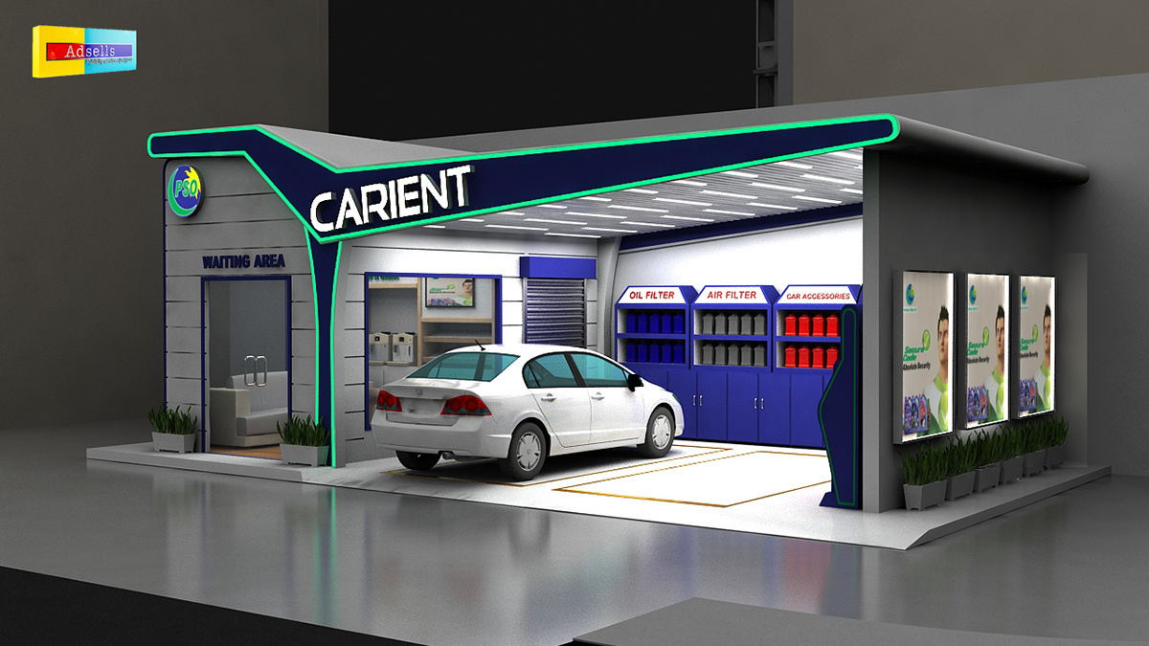

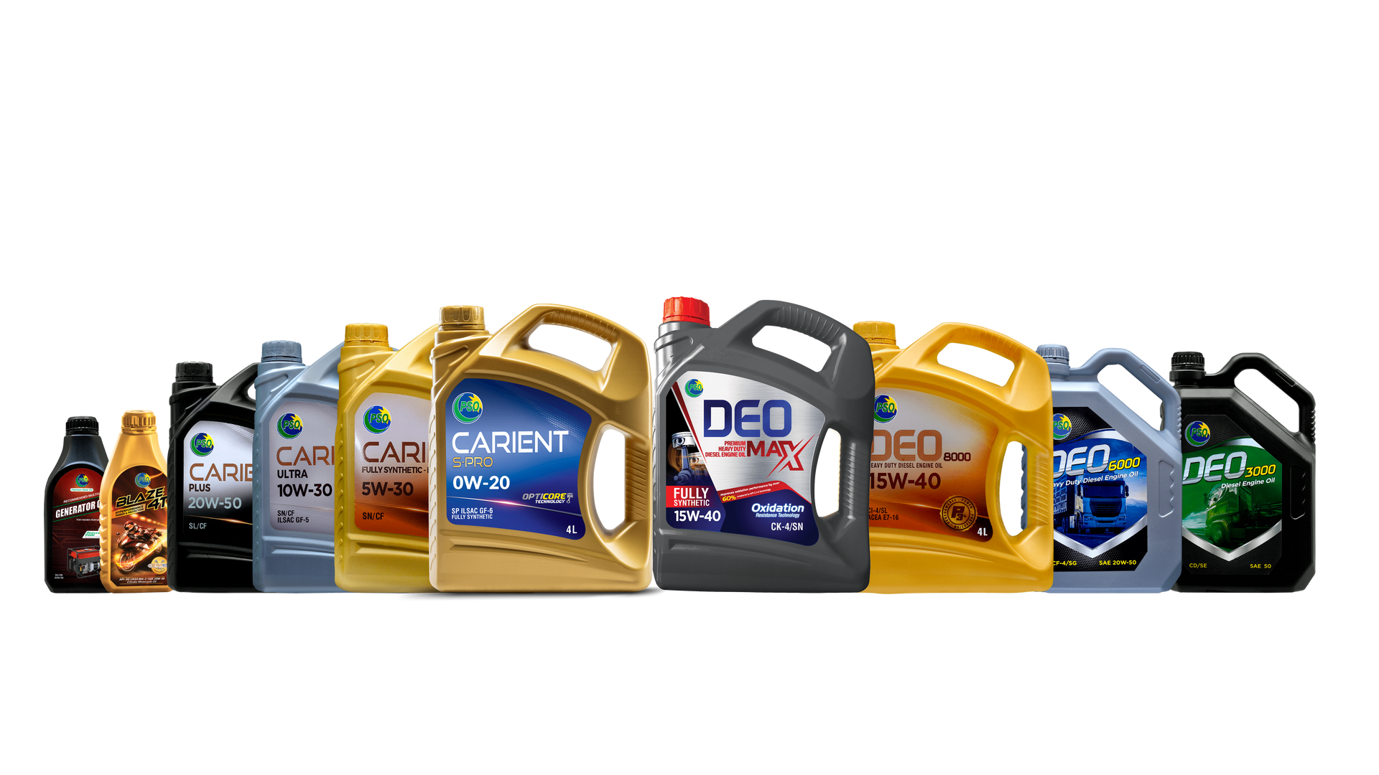
AUTOMATION
Of OCC

Slide 2

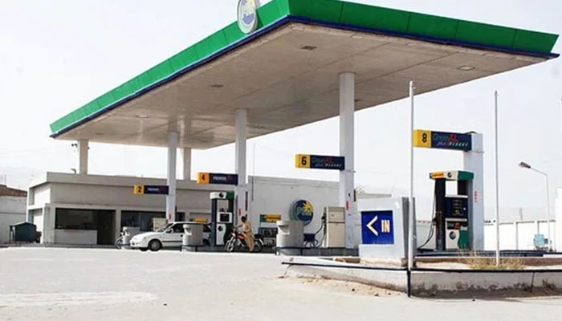





STEP 1
Supervisor
Ms. Shumail Shauque
Assistant Manager – Commercial Sale North
Team
Syed Asad Abbas
Education: BS Computer Science from Hamdard University, Islamabad
Task: Mobile App Development
Ghazia Rashid
Education: BS Computer Science from Bahria University, Islamabad
Task: Web Based Application
Hammad Ahmad Bhatti
Education: MBA (Marketing) from
Quaid-i-Azam University, Islamabad
Task: Sales Analysis Dashboard

Slide 3
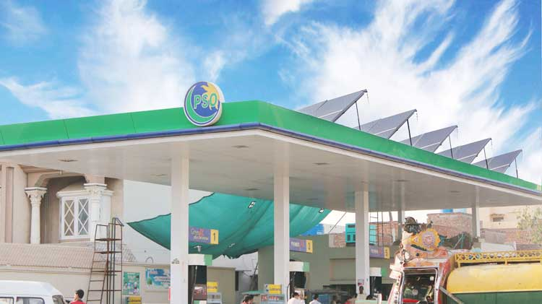

CHALLENGES AND ROADBLOCKS
Manual Sales Recording
Data
Inaccuracy
Lack of Real-Time Insights
Audit & Compliance Challenges
Manual Sales Recording
Data Inaccuracy
Lack of Real-Time Insights
Audit & Compliance Challenges
The current process involves recording all sales manually in registers.
Without automation, real-time insights into sales performance are limited
Manual data entry increases the likelihood of errors.
Manual record-keeping may not adhere to audit standards

Slide 4
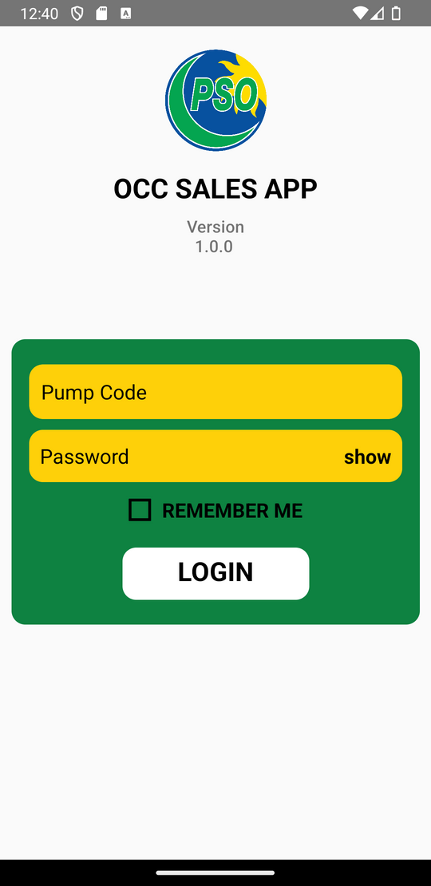



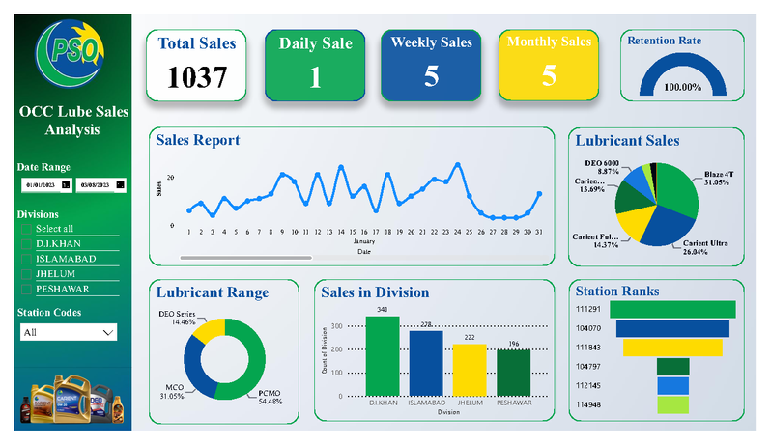
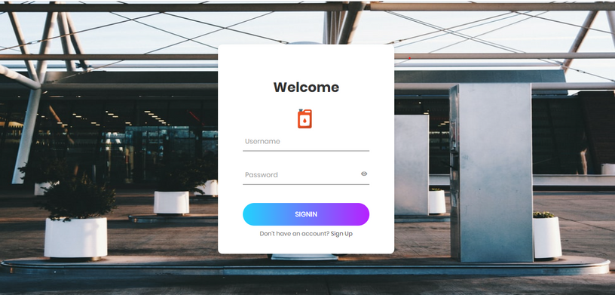
PROJECT
OVERVIEW
This Project contains three Steps
STEP 1
Step 1
Step 3
Step 2
Mobile App
Web Based Application
Sales Analysis
Use at stations for recording lube sales
Receive data from the app and store it in different tables
Visualize sales analysis data by Using Microsoft Power Bi

Slide 5
MOBILE APP DEMONSTRATION

Slide 6
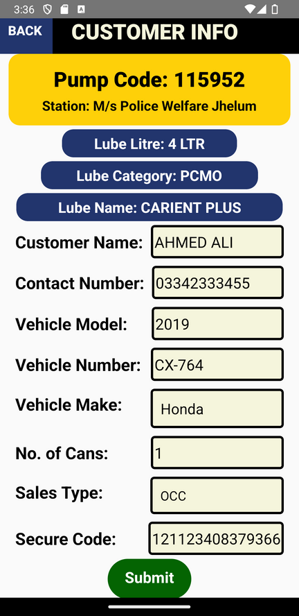
Web Based Application DEMONSTRATION

Slide 7
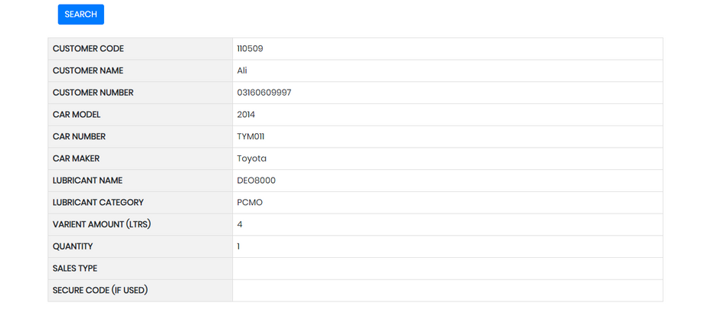
SALES ANALYSIS DASHBOARD

Slide 8
Outcomes
Streamlined Recording Process: Automated the entire sales recording process through the mobile app
01
Enhanced Data Accessibility: Provided easy access to sales data, enabling quick retrieval and efficient data management
02
Real-time Daily Analysis: Implemented live analysis of sales data on a daily basis, enabling timely insights and informed decision-making
03
Enhanced Data Visualization: Utilized data visualization techniques to present sales trends and patterns in a more visually appealing and understandable manner
04

Slide 9

Any
Questions

Slide 10


Thank You

